Slide 1
Non-linear models and analyzing results with R

Slide 2
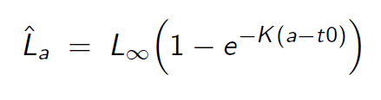
Von Bertalanffy growth
Fill in “vonbert2.tpl” base on Excel file
Calculate standard deviations of predicted length
Include REPORT_SECTION
Plot results in R with “vonbert.R”

Slide 3
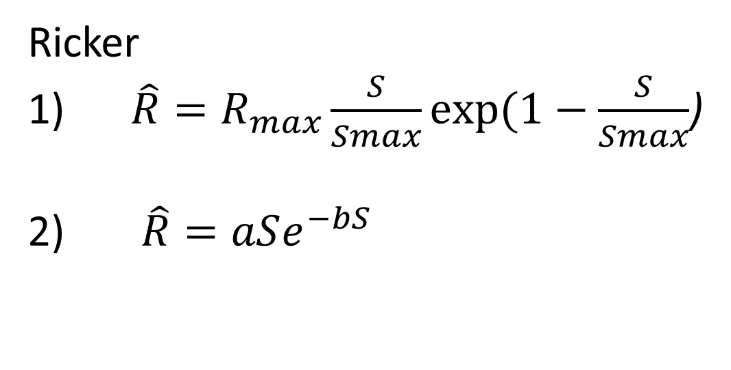
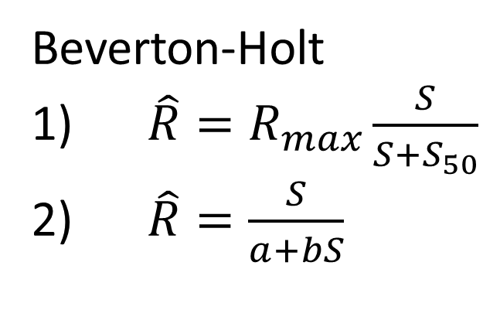
Stock-recruit parameterizations
Beverton-Holt
1) $\hat{R}=R_{max}\frac{S}{S+S_{50}}$
2) $\hat{R}=\frac{S}{a+bS}$
Run two parameterizations of each stock-recruit relationship
Read results into single R script to compare
Ricker
1) $\hat{R}=R_{max}\frac{S}{Smax}exp⁡(1−\frac{S}{Smax}$)
2) $\hat{R}=aSe^{−bS}$

